Slide 1
AIML CA1:
Classification
Emmett Chua • P2222457

Slide 2
Problem statement
Develop a classification model to predict if a customer defaults their payment
Target variable
Default - Finding out which customer does not pay their bills (1s) and which customer pays their bills (0s)
Dataset
1600 rows of data on customers
11 different features [Gender, Education, Marriage status, Age, Credit limit, bill amounts and pay amounts]

Slide 3
EDA : Uni-Variate analysis
Imbalance data set
In the dataset, 78.75% of the customers did not default their payments while 21.25% of them did.
No Null values
None of the 1600 rows of data have any null values or empty values
High standard deviations in numerical columns
Customers have drastically different Credit limits, bill amounts and pay amounts. For example, the credit limit, the maximum is 700k while the minimum is only 10k.

Slide 4
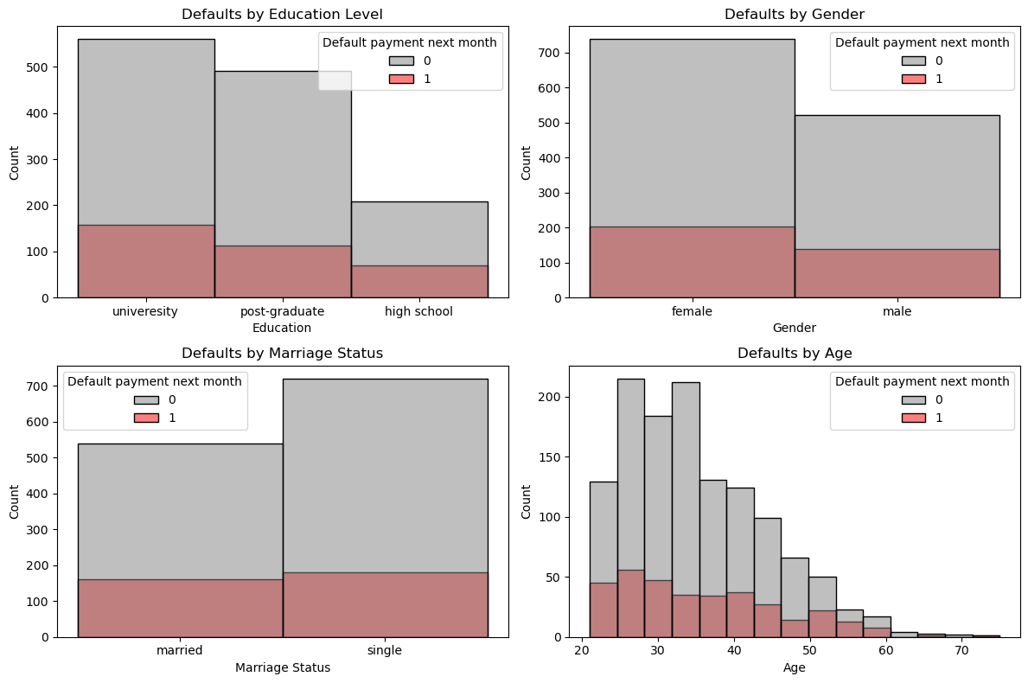
EDA : Bi-Variate analysis
There is no visual correlations between the distributions of the different features

Slide 5
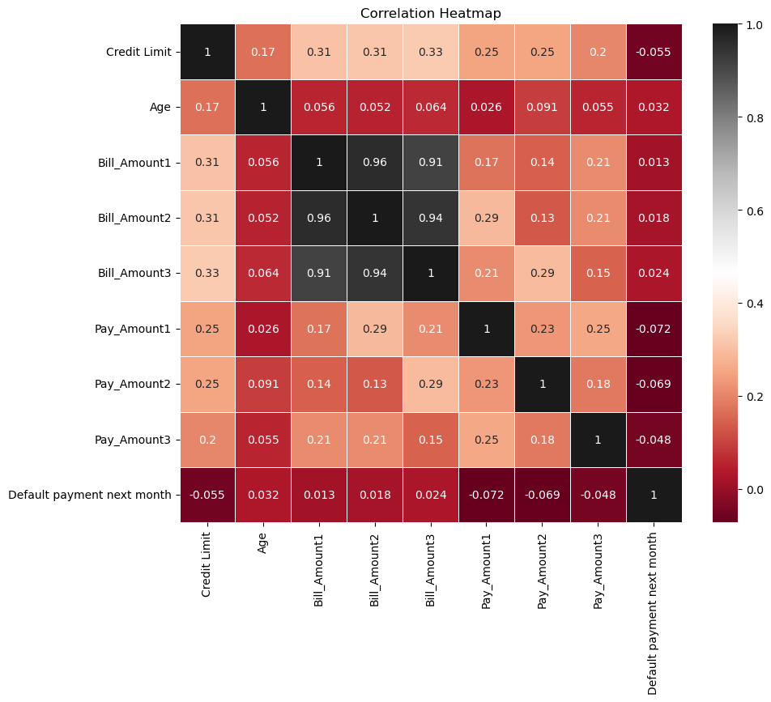
EDA : Bi-Variate analysis
There seems to be some correlation within the billing amounts. However, from a mathematical standpoint, the rest of the features do not seem to have any significant correlation.

Slide 6
Data Preprocessing
1. Encoding
To change categorical features into numerical values so that it can be used for the model, one-hot-encoding was applied
2. Feature Engineering
This helps to improve the predictability of the model. ‘Remainder’, the amount of money owed by the customer and ‘percent_CL’ , a ratio between Remainder and Credit Limit were engineered to the data
3. Data Splitting
8:2 split to leave out some data that can be used to evaluate the model. Cross validation will be used on the training set as well.

Slide 7

Model selection
Models selected
Random Forest (Extra trees)
Gradient boosting classifier
K Nearest Neighbors
Evaluation strategy
Recall score -the proportion of correctly predicted positive instances out of all the actual positive instances.
In this case, we will be looking at the correctly predicted Defaulties (1s)
Comparison to dummy model
The dummy classifier which randomly guesses has gotten a recall score of 79% for non defaults and 0% for defaults
The selected models perform slightly better than the dummy model
Selected model
Gradient boosting classifier has the highest recall score for 1s with a value of 0.09

Slide 8
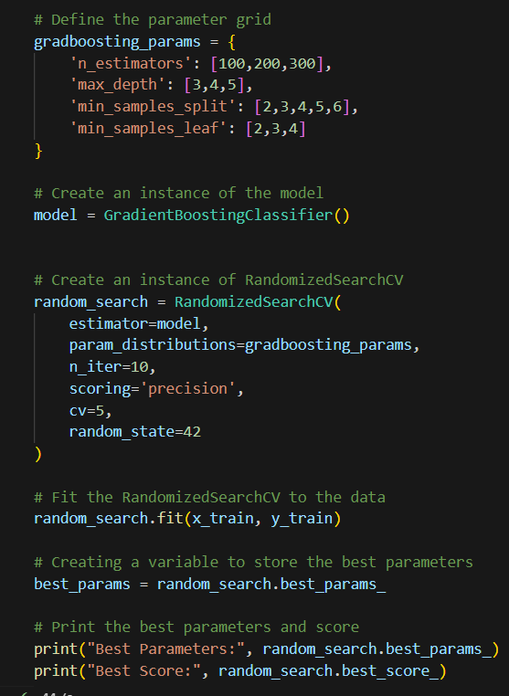
Model tuning
Applying trial and error, a range of values have been selected to find the most optimised parameters for the selected model.

Slide 9
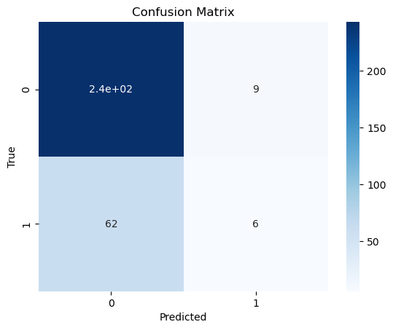
Model evaluation
Most of those who have not defaulted were predicted correctly
Only 6 of the defaulties were predicted correctly

Slide 10
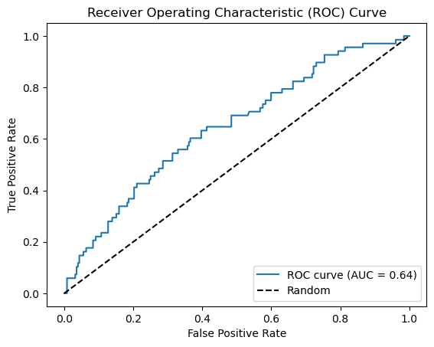
Model evaluation
The score of 0.64 shows that the model’s performance is not the best but still does better than the dummy model which has a score of 0.5

Slide 11
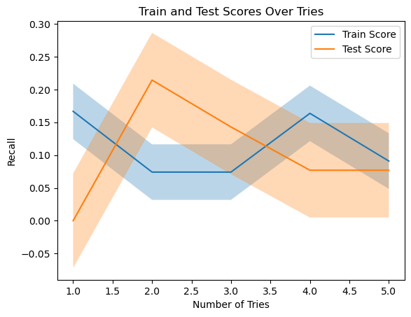
Model evaluation
The train score of the model over some number of tries shows that the classification is not consistent.
The low values of the model also shows that the classification is not good. This could be a result of the lack of training data for defaulties.

Slide 12
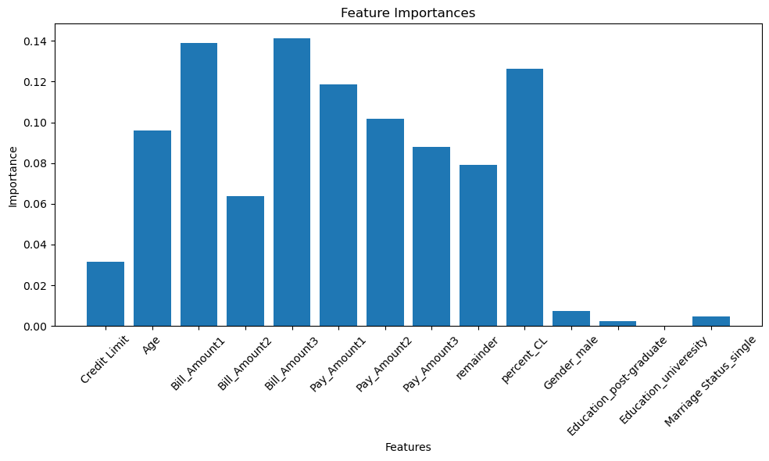
Feature importance
There is no significant feature that the model takes into consideration the most.
It is difficult to say that we should only take the bill amounts and percent_CL as well despite the fact that they are the highest importance. A huge amount of valuable data will be loss and the result would not be very good

Slide 13
Solving the issue of the data being imbalance by oversampling
After applying simple oversampling where the number of defaults and non defaults are the same, the evaluations improved.
Using the best parameters, the model is able to achieve a recall score of 0.96 for Defaulties. This is a drastic improvement from before
This confirms that the model does not have poor performance but is actually lacking in training data

Slide 14
Conclusion
Issue of imbalance dataset
The imbalance dataset affects the classification of the model and there is not enough data for the model to perform well.
Approaches for solving the issue
The best approach would be to collect more data and more cases of defaults in order to get a better prediction. The current amount of Defaults are not sufficient for the model to classify well

